Slide 1

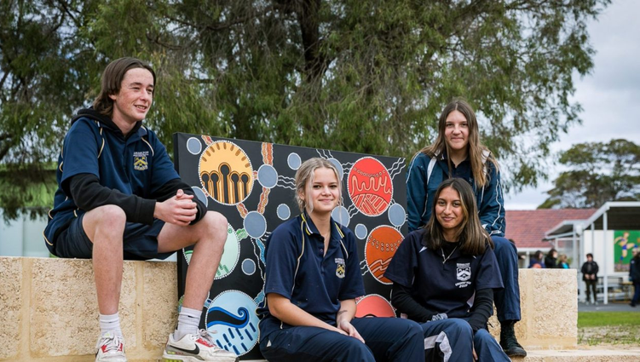
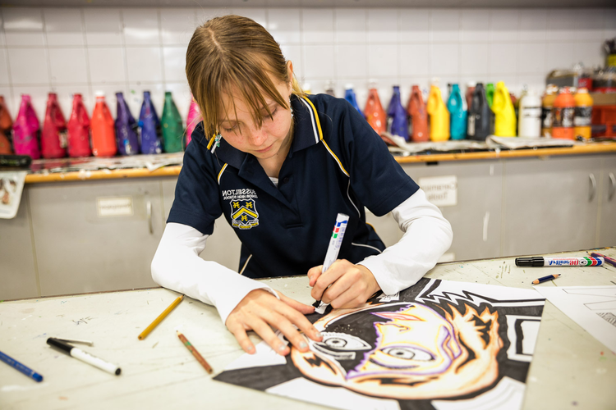
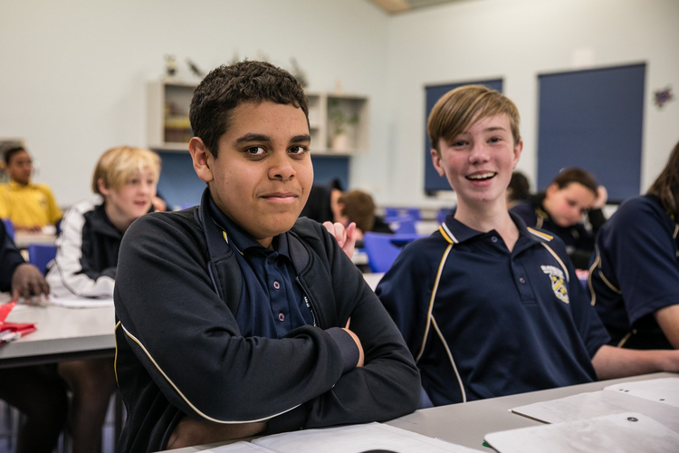
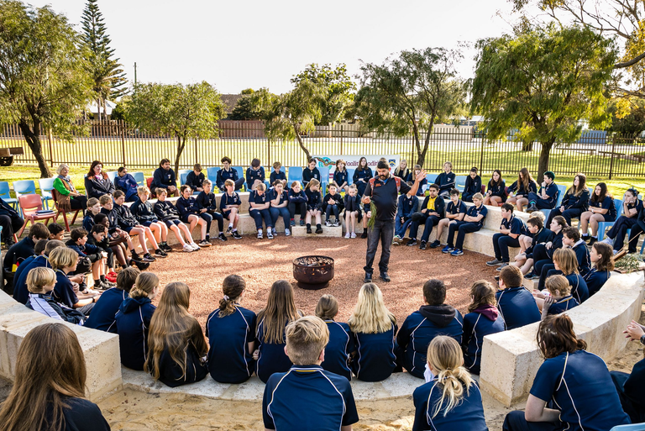
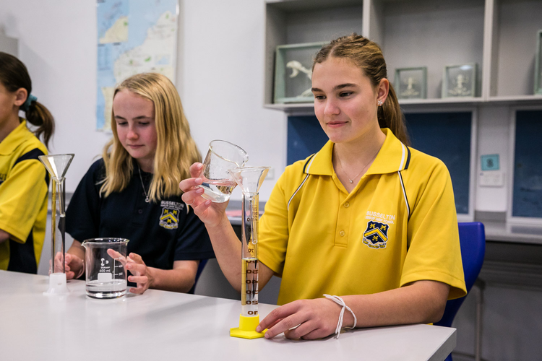
PBS
LESSON
2023
Day 1 - 2023
BUSSELTON SENIOR HIGH SCHOOL

Slide 2
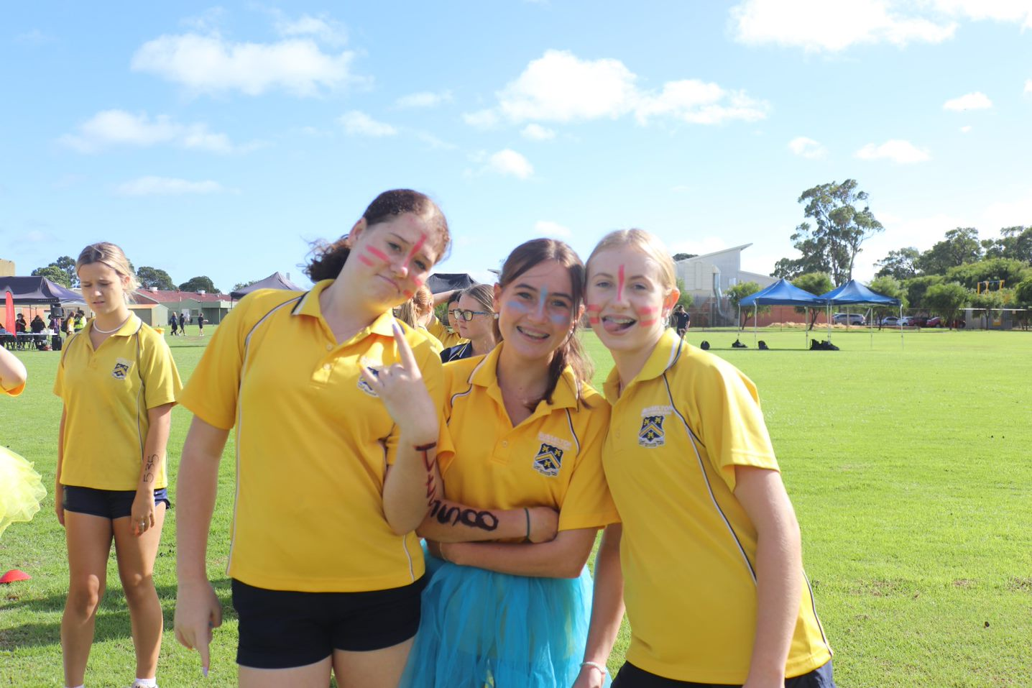
REAL Values
BUSSELTON SENIOR HIGH SCHOOL HAS 4 SCHOOL VALUES:
Respect
Empathy
Achieve
Learn
REAL

Slide 3

REAL MATRIX
The REAL Matrix includes our school wide expectations that students should display regarding certain situations. They are:
All Settings
Classroom
Self

Slide 4
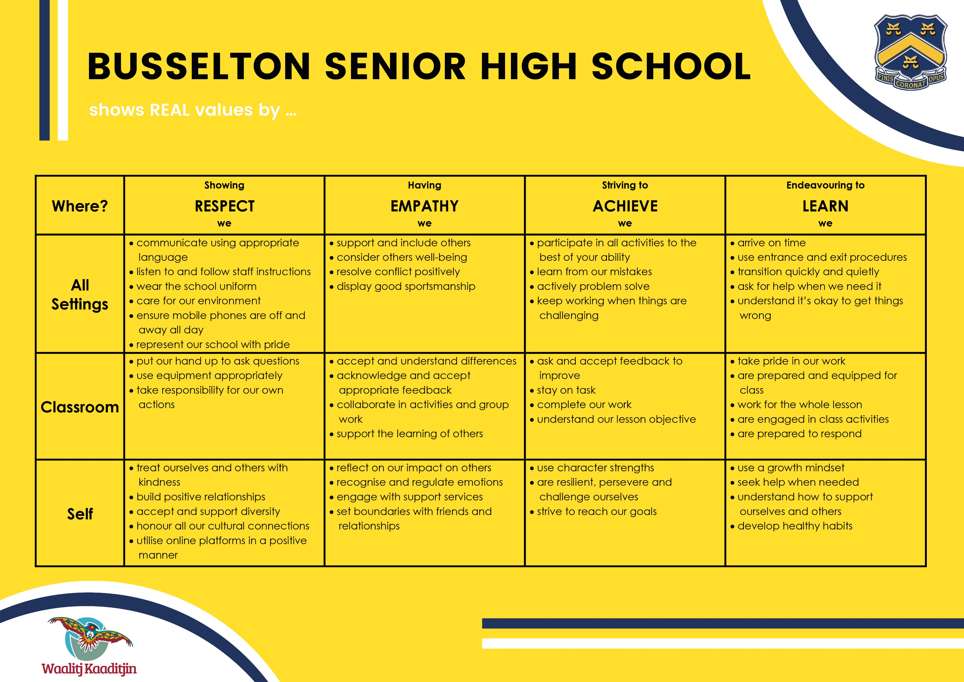
REAL MATRIX

Slide 5
At BSHS we show respect by;
Communicating using appropriate language
Listening to and following staff instructions
Wearing the school uniform
Caring for our environment
Ensuring mobile phones are off and away all day
Representing our school with pride

Slide 6
At BSHS we have empathy by;
Supporting and including others
Considering others well-being
Resolving conflict positively
Displaying good sportsmanship

Slide 7
At BSHS we strive to achieve by;
Participating in all activities to the best of our ability
Learning for our mistakes
Actively problem solving
Keeping working when things are challenging

Slide 8
At BSHS we endeavour to learn by;
Arriving on time
Using the entrance and exit procedures
Transitioning quickly and quietly
Asking for help when we need it
Understanding it’s okay to get things wrong

Slide 9
Classroom specific expectations:
Name three classroom specific expectations for you and your classroom:
e.g.
Use equipment appropriately.
Treat ourselves and others with kindness.
Participate in all activities to the best of your ability.
NAME OF TEACHER’S CLASSROOM

Slide 10
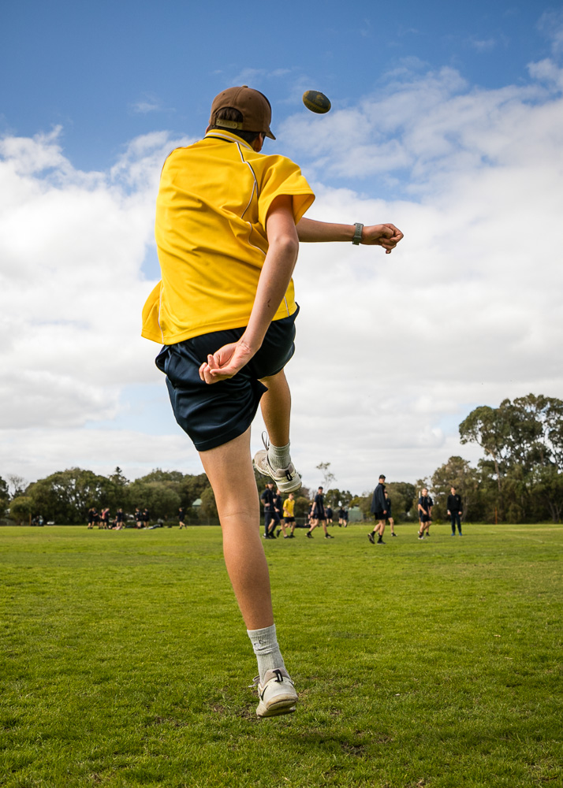
Entry procedure –
Move sensibly in a safe manner
Line up in two lines outside your class
Follow the classroom bag protocol
Have your equipment organised before you enter the class
Listen to staff instructions to enter

Slide 11
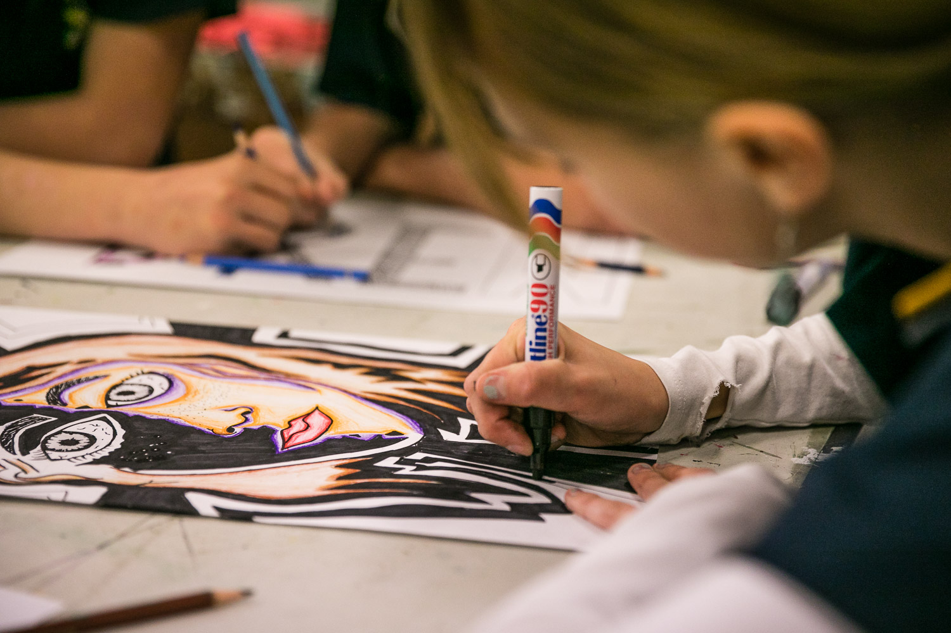
Exit procedure –
Cue to pack up.
Lesson reflection.
Final message from teacher.
Sit/Stand as instructed until class is quiet.
Dismissed by teacher.
Transition in an orderly fashion to the next class/break.

Slide 12
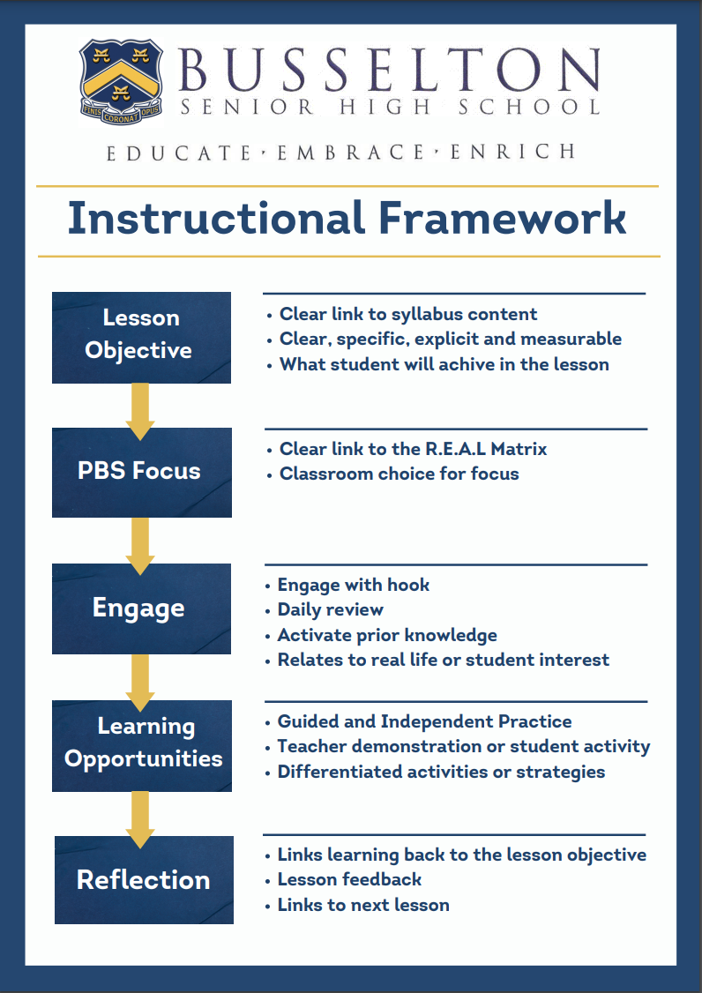
BSHS CLASSROOM LESSONS
Each of your lessons, in every learning area will follow a similar lesson structure. That is:
Lesson Objective
PBS Focus
Engage
Learning Opportunities
Reflection
The Instructional Framework helps create a common and consistent approach to teaching across BSHS.

Slide 13
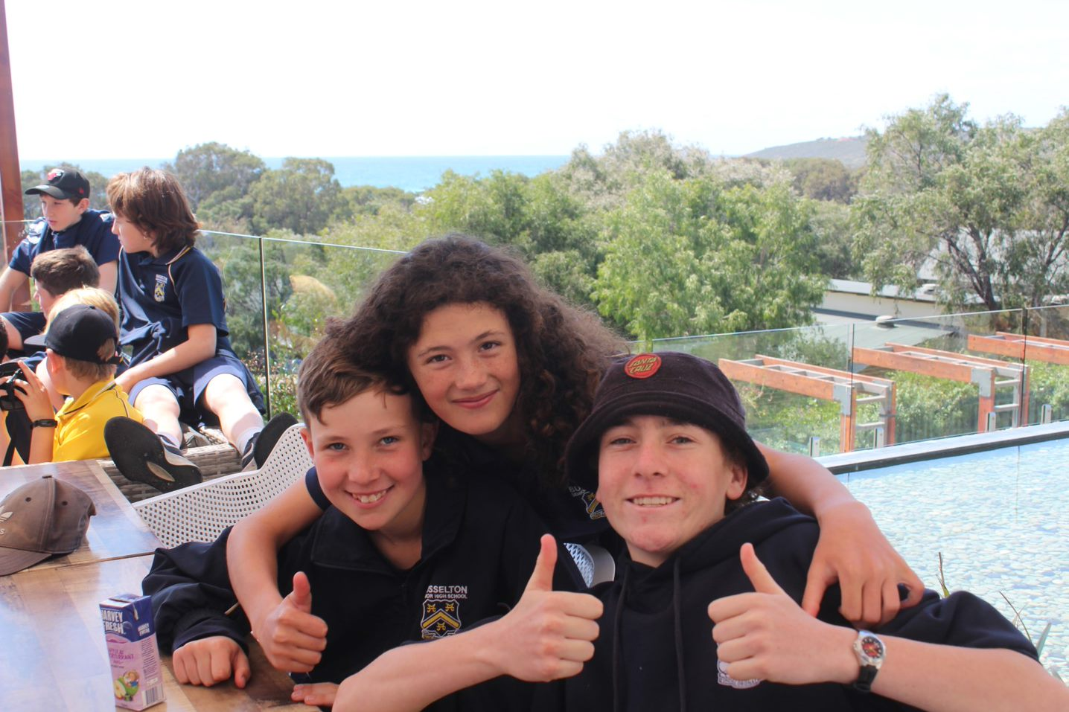
PBS Lessons
Each week your Tuesday P1 class (for Year 9s, P2) will receive a PBS lesson based on one of these expectations.
This is an opportunity to you to revise our expectations of you and your peers. These may be on anything from transitioning to class, displaying sportsmanship or mental health.

Slide 14

PBS Points
If you display the positive behaviours, you will receive PBS Points. Teachers will give out one point per specific expectation demonstrated.
Points this year will be tallied on Compass, where you can check at home and on the Compass App!
An easy way to score 5 points per lesson:
Arrive on time.
Wear the school uniform.
Be prepared and equipped for class.
Be engaged in class activities.
Support the learning of others.

Slide 15
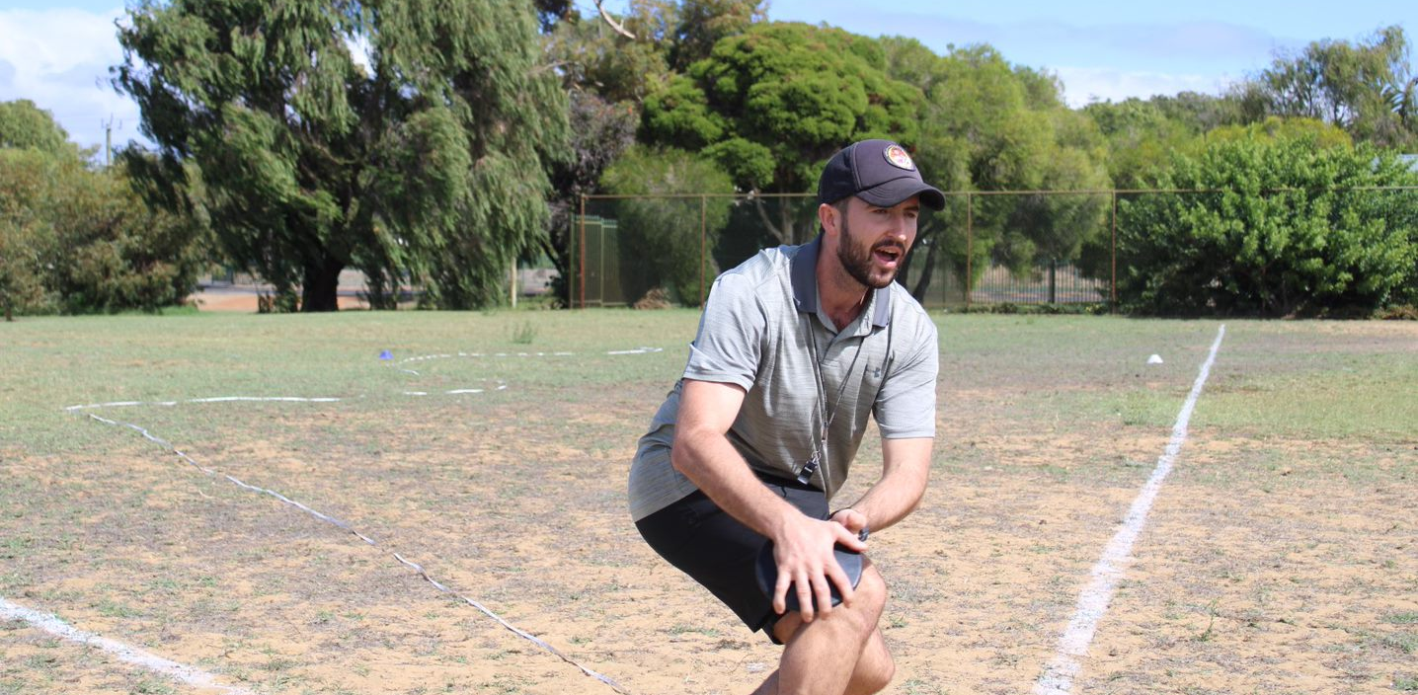
PBS Points
You can earn PBS Points anywhere. Remind teachers on duty and on excursions to rewards students for displaying positive behaviours.
Staff may choose certain expectations that are important to them in their classrooms – make sure you know them!

Slide 16
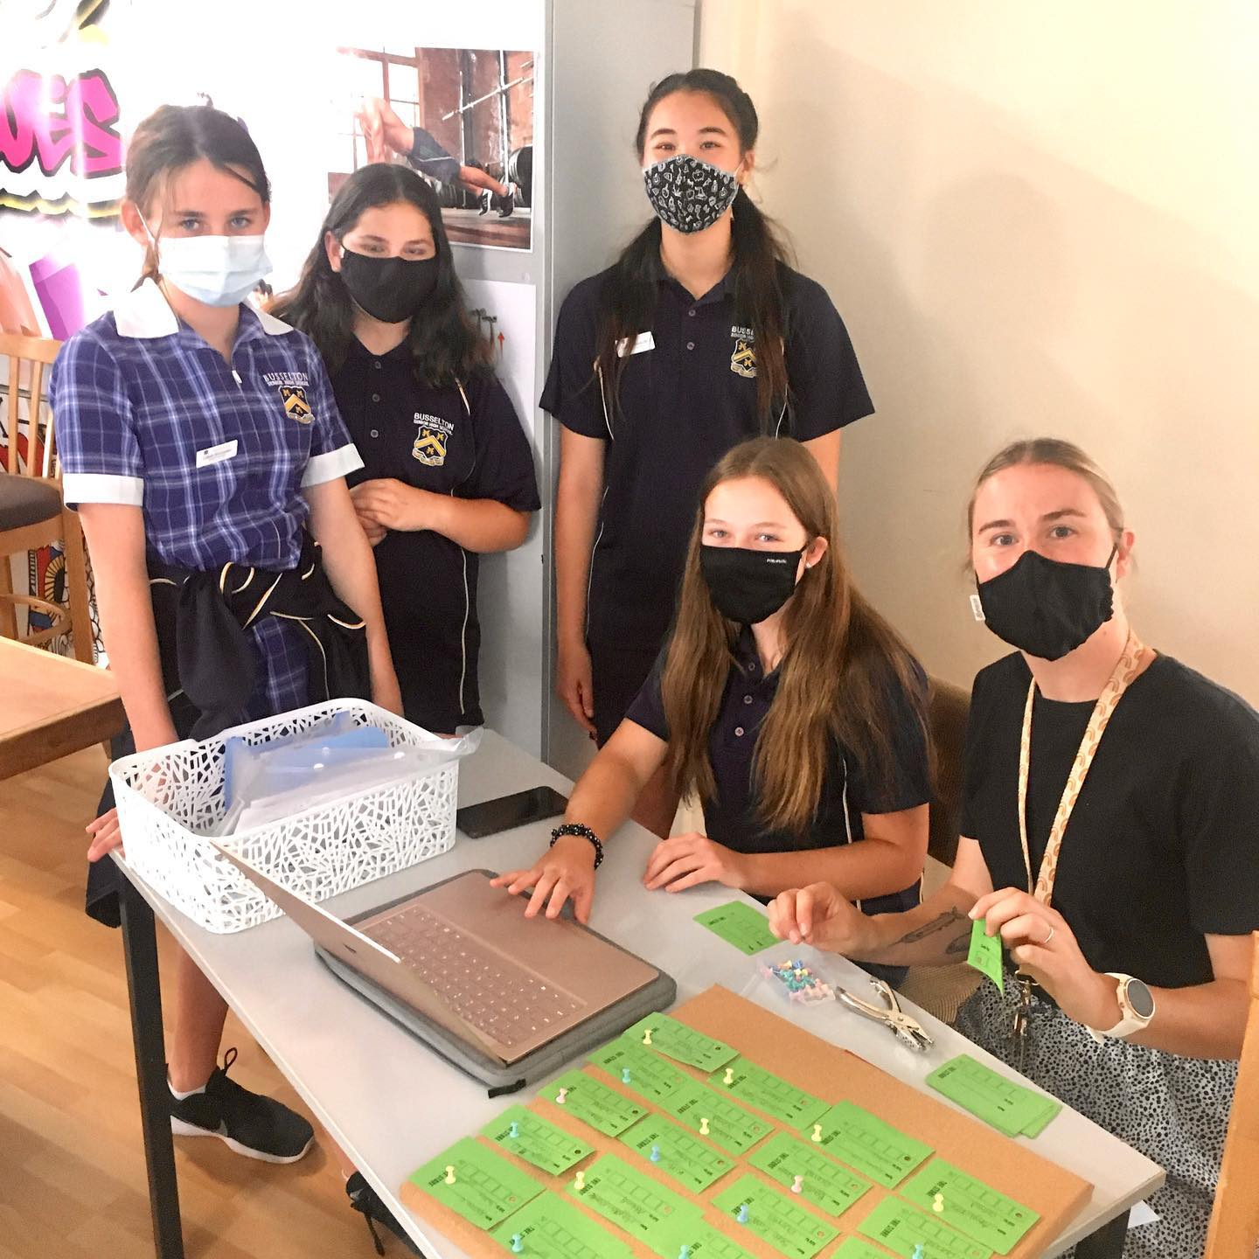
Redeeming your points
Located at our student Hub, the PBS store is where you can redeem your points for:
Canteen vouchers (1 point = 1 cent)
Experiences (Principal’s carpark)
Goodies (TechDecks, sensory toys, bouncy balls)
Stationary!
The Hub is open at Break 1 & 2 every day, and items are sold by the teacher on duty. The Hub may be closed if teachers are away.

Slide 17
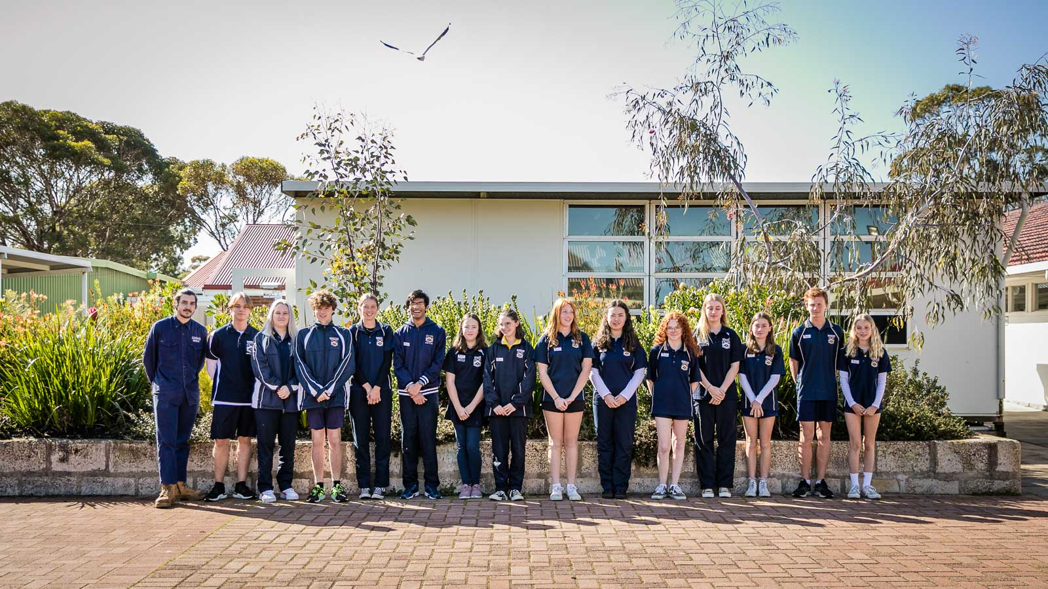
UNIFORM
Busselton SHS are proud of the identity of our school uniform. Our distinctive blue, gold and white are well recognised within the local community and we encourage our students (with the support of their families) to wear the uniform with pride.

Slide 18
UNIFORM
CLOTHING ITEM | ACCEPTABLE (YES) | NOT ACCEPTABLE (NO)
POLO SHIRTS | Navy Blue School Polo Only Not yellow sports shirt | Polo shirts with non school logos T-shirts or tank tops Long sleeved non school colour tops School shirts MUST be worn under school jumpers
PANTS / SHORTS / SKIRTS | Navy Blue Acceptable length (below length fingertip length) No logos | Denim or lookalike denim or jeggings Black leggings or tights leggings/tights are not to be worn on their own Stripes on shorts, pants Board-shorts
JACKETS | Navy Blue and School Issue School logo must be present Tenderfeet jumpers acceptable Tenderfeet hoodies not to be worn in D&T classrooms | No hoodies Non school colours or checked jackets No different logos or stripes No adornments/brand names eg. Nike, Puma, Everlast etc.
FOOTWEAR | Enclosed shoes Sandals with a strap Appropriate for Learning Area | No thongs, Crocs, ugg boots, slippers
HATS/BEANIES |  | Not allowed in classrooms

Slide 19





PBS Mascot Competition
We have our school wide expectations, but we don’t have a mascot/symbol of this!
The whole school community is invited to make suggestions for a REAL mascot.
Suggestions can be dropped off at Student Services by Week 5, Term 1 in the suggestion box.
Bonus award for a drawing of the character!

Slide 20
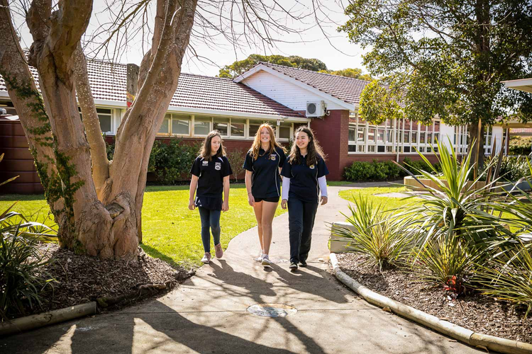
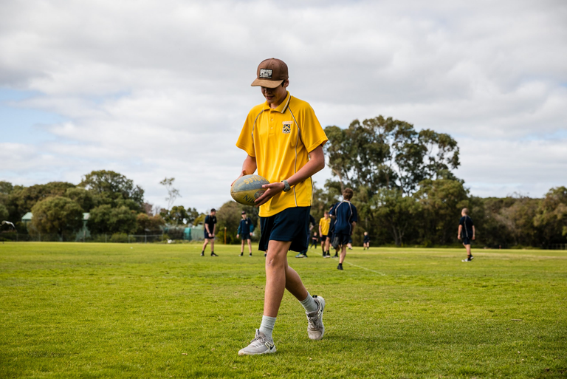
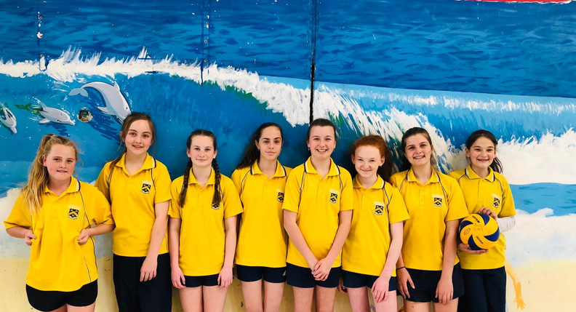
HAVE A GREAT START TO 2023!

Slide 21


2023
THANK YOU
PBS LESSONS
Don't forget to check on your PBS Points on Compass!

Slide 22

Welcome to Maths!

Slide 23

Today we are going to:
Learn the classroom routines
01
Entry and exit
pop stick names
Organise our workbooks
02
Start some maths!
03
Whiteboards
Expectations
Intro to topic

Slide 24


What are our expectations?
Arrive on time for lessons
Line up sensibly outside and enter the classroom quietly
Make sure you have the correct equipment / books out on the table
Listen carefully to instructions
No shouting out
No talking when others are talking - whether it's the teacher or another member of the class
Be respectful at all times and show empathy to each other
Positive, hard-working attitude - consequences
All lesson tasks / activities must be attempted - effort
All homework must be completed when required

Slide 25
Entering the classroom
No food no phones
Hats off
Come in quietly, find your file and sit down
Write down the lesson purpose/objective (on the board)

Slide 26
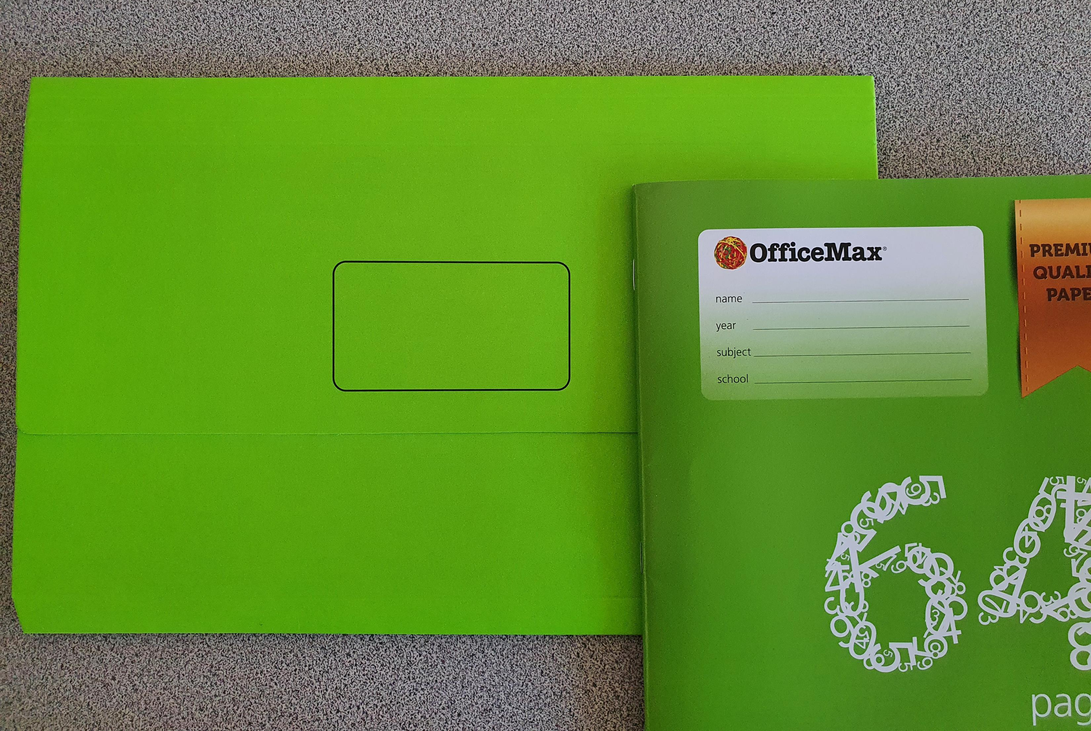
Please put your name on BOTH folder and exercise book

Slide 27
Standards
This is how you are expected to complete work and notes.
USE BOTH SIDES OF THE PAPER IN YOUR BOOKS!

Slide 28

Lesson objective
Title: Negative numbers and opposite statements
Aim:
I can complete a number line.
I can state the opposite of a number.
Plan:
Class routines
Mini whiteboards
Topic discussion
Skills practice
Notes:
Explain where to start in the book for each lesson (most recent page), the date and topic title

Slide 29


Slide 30
Choral response
Good learners go into the pit and come out of the pit with new learning, ready for the next challenge.
Good ______ go into the pit and come out of the pit with new learning, ready for the next challenge.
Good ______ go into the pit and come out of the pit with new learning, ready for the next _______
What do good learners do?

Slide 31
Setting up our personal whiteboards
Each person needs:
Plastic sleeve
1 piece of card
1 piece of grid paper
1 piece of isometric paper
Write your name on the top right of the grid paper, so you can see it.
Place the paper and card into the plastic sleeve so that the card is in the middle and is covered by the other pieces of paper.

Slide 32
Whiteboard routine
What I do
What you do
Give you the question
“hover when ready”
“chin it”
“bin it”
8 – 10 seconds to write an answer
Whiteboard hovering over your desk
Show me your answer
Clear your answer, ready for next question

Slide 33
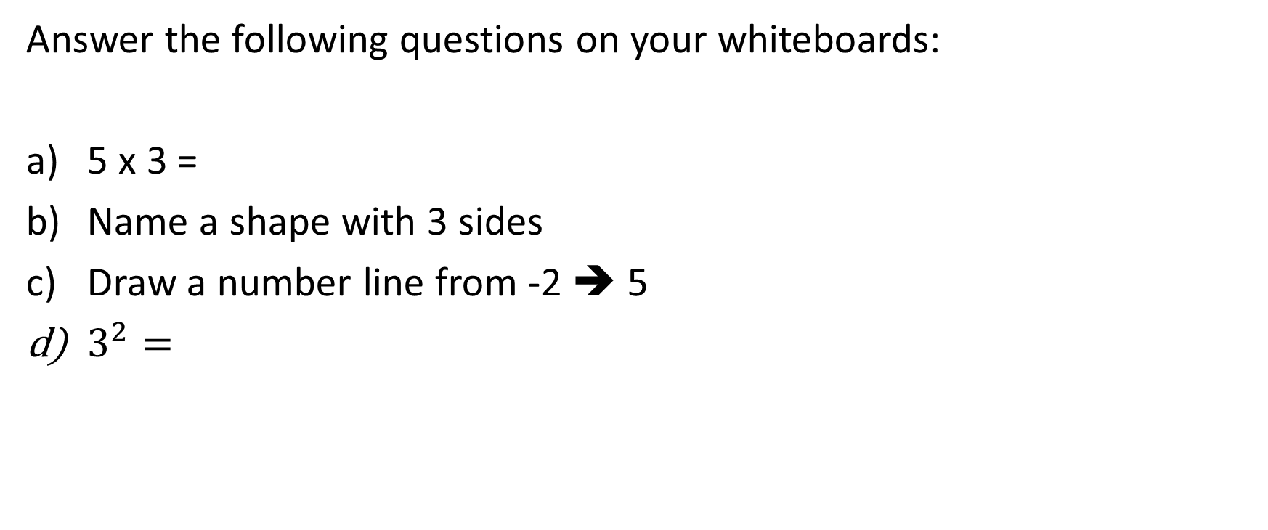
Quick math whiteboard practice
Answer the following questions on your whiteboards:
5 x 3 =
Name a shape with 3 sides
Draw a number line from -2 ➔ 5
$3^{2}=$

Slide 34
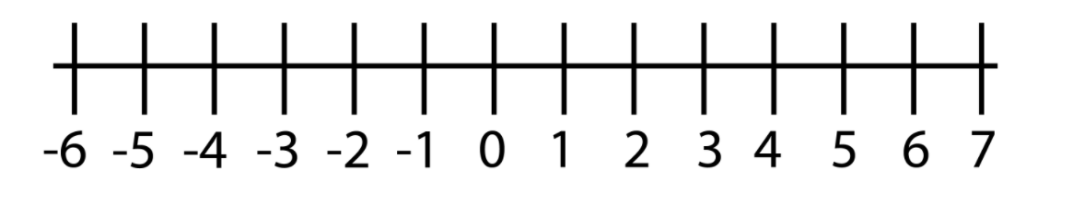
Number line and opposite numbers
What is missing from this number line?

Slide 35
Opposite numbers
https://www.youtube.com/watch?v=2Zk6u7Uk5ow

Slide 36
Choral response
The opposite of a number is going to be the opposite sign of that number.
The opposite of a number is going to be the opposite ____ of that number.
The opposite of a number is going to be the opposite ____ of that ______.

Slide 37

Grade Descriptors

Slide 38
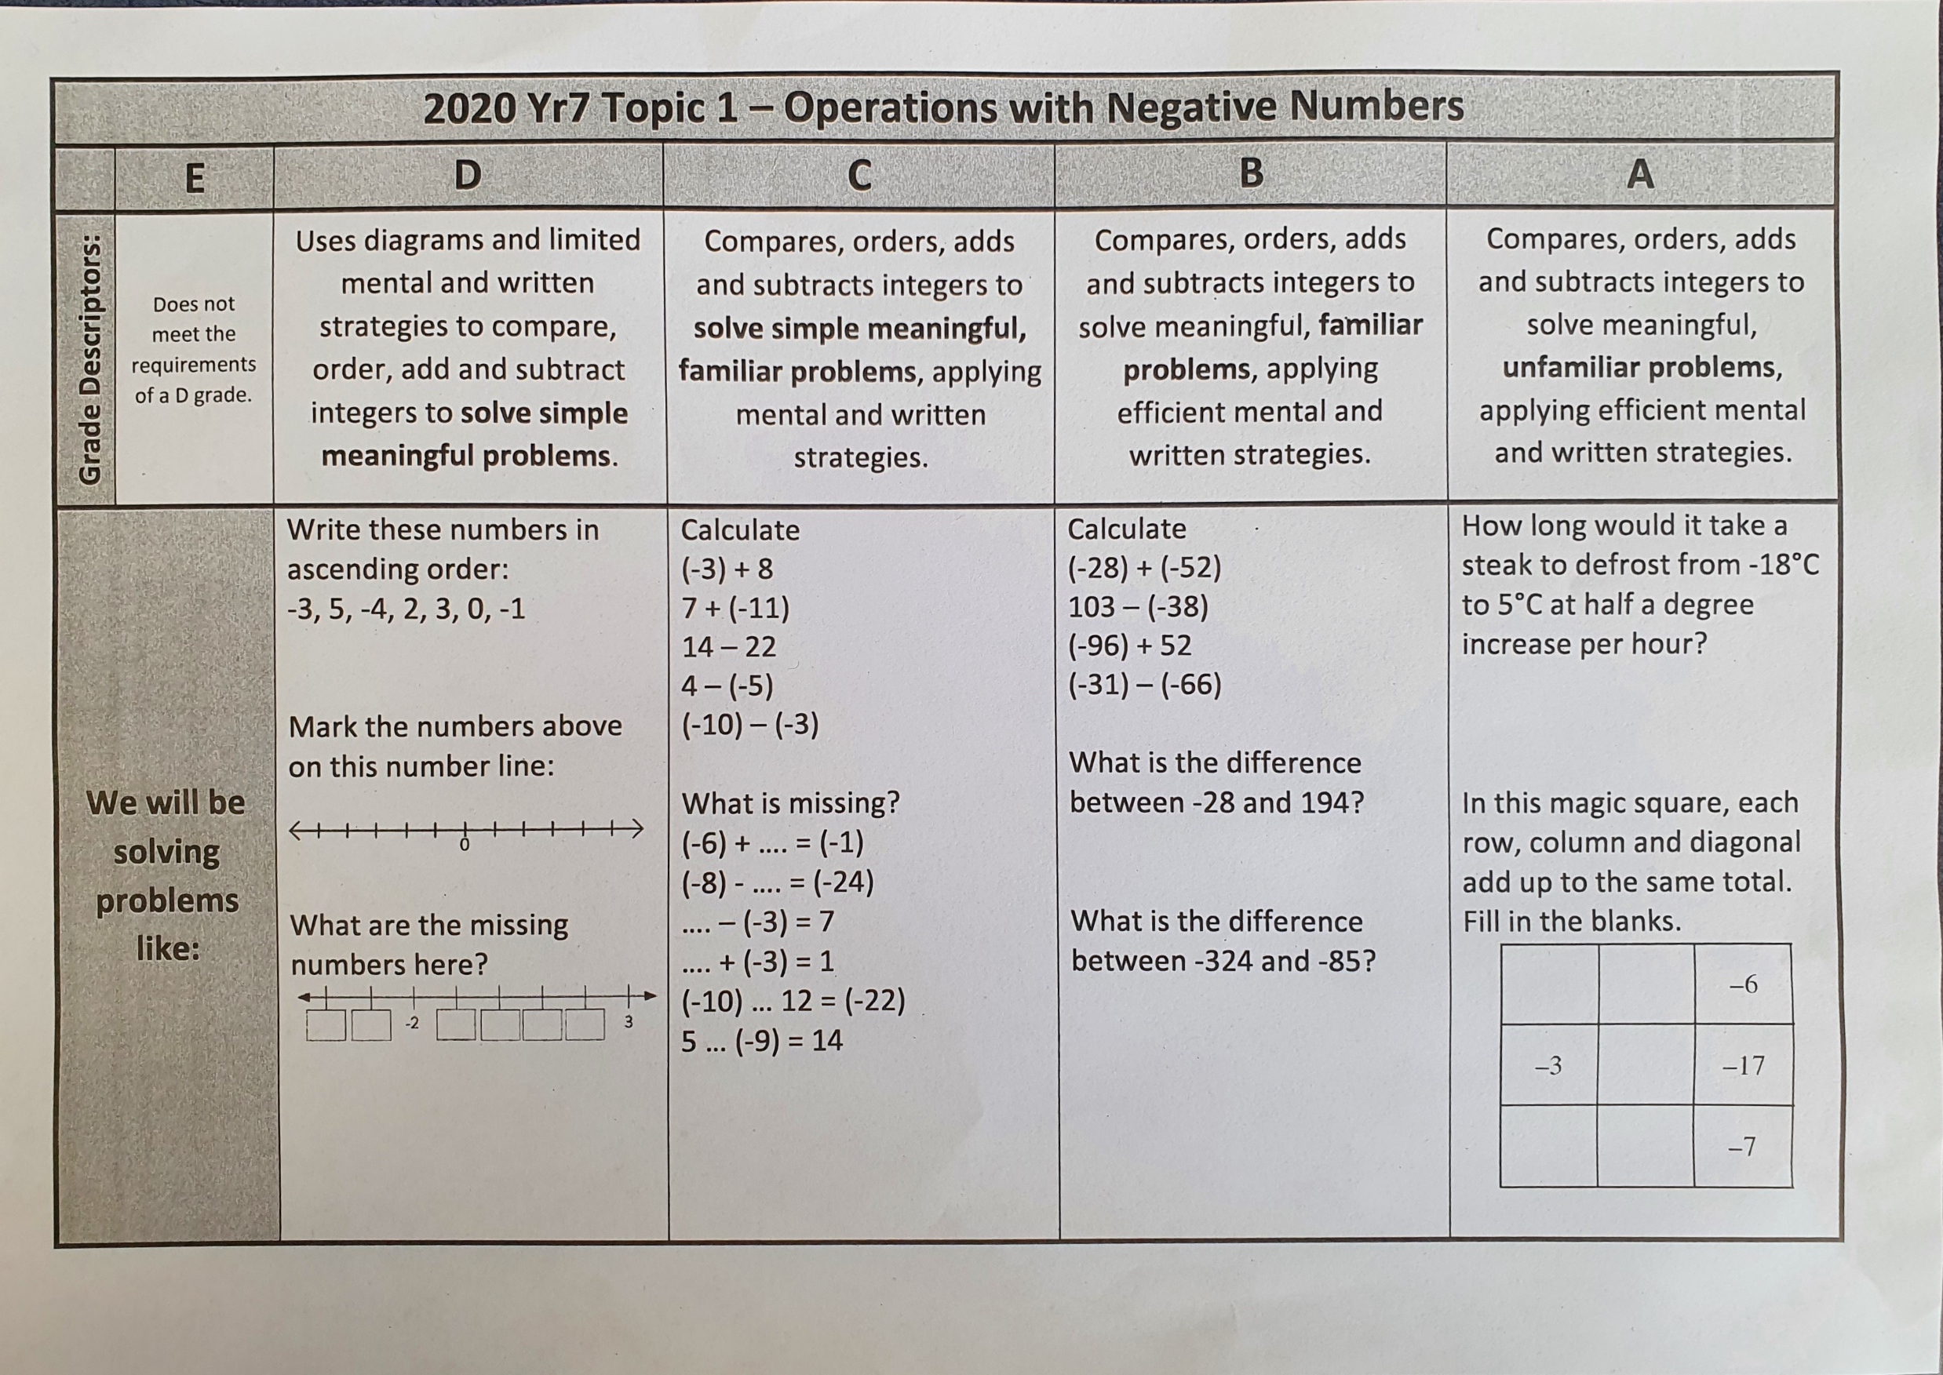

Slide 39
In your exercise book, evaluate the following:
Complete the number line:
State the opposite number to:
4
8
-5
-10
-123
What is the missing number?
4 + __ = 10
14 - __ = 6
__ + 3 = 15
2 x __ = 12
15 ÷ __ = 5
2
0
-3

Slide 40
Success criteria
I can complete a number line.
I can state the opposite of a number.
Fist to five

